Slide 1

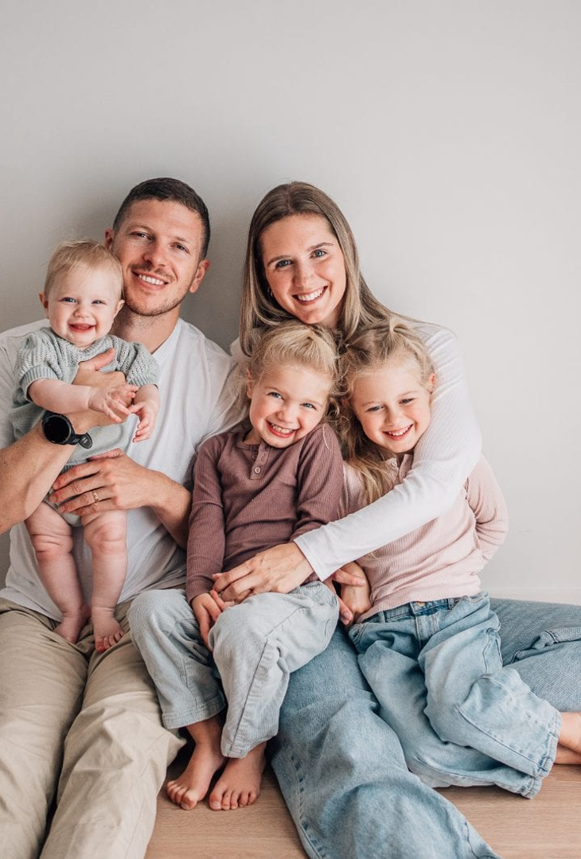

⛨
UAE AI AGENTS CHAMPIONSHIP · PROJECT PITCH
GuardianLoop.Ai
The Child & Home Hazard-Response Agent — an extra layer of protection for balconies, windows and household hazards, from instant alert to verified resolution.
◉
Computer Vision
◔
Instant Alerts
✓
Resolution Tracking
Because every child deserves one more guardian watching.
PRESENTED BY
Ravi Kumar D
October 2026
WATCHED ZONES
▦
Balconies · Windows · Wiring & doors
Notes:
- Greet the judges confidently and introduce yourself: “Good morning — I am Ravi Kumar D.”
- Give the one-line definition: GuardianLoop.Ai is a child & home hazard-response agent.
- Frame it as an extra layer of protection: balconies, windows, household hazards — from instant alert to verified resolution.
- Set the context: UAE AI Agents Championship project pitch, October 2026.
- Transition: “Let me start with why we chose this idea.”

Slide 2

Why We Chose This Idea
Two simple truths about family life guided this project.
◔
⚒
Children are fast. Hazards are close.
Broken things stay broken.
In the few seconds a parent looks away, a toddler can reach a balcony edge, an open window or a damaged switch. That tiny gap in attention is all it takes — and it happens to the most caring parents.
A cracked switch or exposed wiring often stays unrepaired because nobody tracks the fix. Reports get forgotten, and a small hazard quietly grows into a dangerous one.
81
reported child fall cases in the UAE (2005–2016)
✓
OFFICIAL SOURCES WE STAND ON
66
of them fatal
Abu Dhabi Public Health Centre — Safety of Children at Home Guide
27%
involved furniture near windows or balconies
https://www.adphc.gov.ae/-/media/Project/ADPHC/ADPHC/PDF/Child-Injury-prevention/Child-Safety-Home-En.pdf
World Journal of Emergency Surgery (2017) — Child falls from windows & balconies in the UAE, 2005–2016
https://pmc.ncbi.nlm.nih.gov/articles/PMC5644057/
♥
Behind every number is a name a family still misses.
Notes:
- State the two truths in plain words: children are fast and hazards are close; broken things stay broken because nobody tracks the fix.
- Name the two official sources: the ADPHC Safety of Children at Home Guide and the 2017 World Journal of Emergency Surgery study on UAE falls.
- Point to the numbers: 81 reported child falls, 66 fatal, 27% involving furniture near windows or balconies.
- Slow down and land the emotional line: behind every number is a name a family still misses.

Slide 3
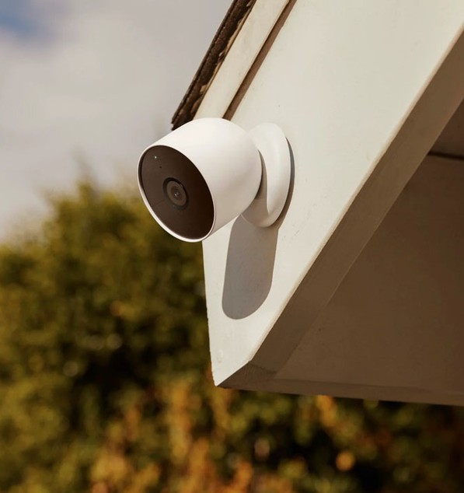
Prerequisites — Setting Up the Guardian
✚
One fixed camera, safely mounted, focused on the danger zones — never around a child's neck, never within a child's reach.
✦
Balconies & terrace doors
Detect open access and a child approaching the edge
✦
Windows
Monitor zones near climbable furniture — furniture near windows was involved in 27% of reported UAE falls
⚡
Switchboards, wiring & damaged fittings
Spot visible electrical damage before it becomes an emergency
✦
Doors, gates & utility areas
Watch the paths that lead to every unsupervised corner
▶
Fixed, high-mounted, out of reach — watching the risk zone, not the child's face.
SETUP PRINCIPLES
✓
Fixed & high-mounted
✓
Local processing preferred
✓
No facial identification
✓
Defined risk zones only
Notes:
- Walk the judges through the four mounting zones: balconies & terrace doors, windows, switchboards/wiring, doors & utility areas.
- Quote the evidence hook: furniture near windows was involved in 27% of reported UAE falls.
- Stress the safety-first mounting rule: one fixed camera, high and out of reach — never around a child's neck, never within reach.
- Point to the principles chips: local processing, no facial identification, defined risk zones only.

Slide 4
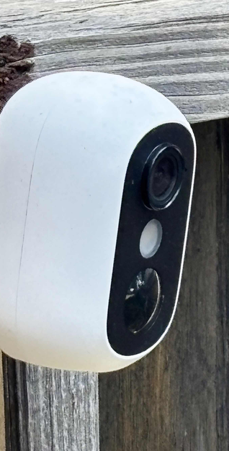
Our Use Case — From Hazard to Resolution
One agent, two very different jobs — because a child near a balcony door and a cracked switch must never be handled the same way.
PATH A · Immediate child-safety events
PATH B · Household maintenance hazards
1
Observe — fixed cameras watch defined risk zones
1
Report — camera or resident flags damage (cracked switch, exposed wiring)
2
Detect — a child-sized person enters a zone, or a balcony door / window opens
2
Classify — logged as a potential hazard with a confidence level
3
Alert — local alarm + caregiver notification fire instantly on pre-approved rules
3
Track — case flows: open → assigned → in progress → reported complete
4
Escalate — if nobody acknowledges, the emergency plan escalates at once
4
Verify — closure only with real evidence; routine items get polite follow-up
The guardian that never blinks.
⚡
A toddler near an open balcony door → alarm in seconds. A cracked switch → a case a technician actually completes.
Urgent gets urgency. Routine gets follow-through. Families get both.
Notes:
- Contrast the two paths: Path A is life-safety urgency, Path B is maintenance follow-through.
- Explain why they must be separated: different clocks and different rules — a child near a door cannot wait behind a maintenance queue.
- Use the mini-scenarios: toddler near an open balcony door → alarm in seconds; cracked switch → a tracked case a technician actually completes.
- Stress Path B's verify-before-close: closure only with real evidence, plus polite follow-up on routine items.

Slide 5



♥
WHY THIS MATTERS
Babies are our world —
for their mom and dad.
To a mother and father, a child is not a part of life — the child is life itself. Every parent promises to protect that little world, yet no parent can watch every second of every day. GuardianLoop exists for the parents who give everything, and simply need one more guardian watching in the seconds they must look away.
This is not surveillance. It is love, engineered.
Notes:
- Slow down — let the photo and the room breathe before speaking.
- Read the headline aloud to the judges: “Babies are our world — for their mom and dad.”
- Deliver the paragraph gently: parents give everything, yet cannot watch every second.
- Pause before the sign-off, then close: “This is not surveillance. It is love, engineered.”

Slide 6
Technical Explanation — The GuardianLoop Agent Loop
1
Observe
2
Interpret
3
Plan
4
Guardrails
cameras, sensors & user reports with source + timestamp
convert to structured events with confidence & uncertainty
propose the right action sequence for the event
deterministic code checks safety rules & permissions before any action
5
Execute
6
Verify
7
Recover & Escalate
8
Audit
raise alarm, notify caregiver, open maintenance case, book technician
inspect real tool results — a sent message is not a resolved hazard
retry safely, then hand over to humans per policy
keep a proportionate event record of every decision
▶
Computer vision
▤
Policy engine
✓
Resolution tracking
child-sized person detection in configured risk zones on fixed cameras
urgent alerts run on deterministic, pre-approved rules — never queued behind an LLM conversation
case states open → acknowledged → assigned → in_progress → verified_or_unconfirmed
Every technical step exists so that one family never learns the worst way.
Notes:
- Walk the loop in order, 1 → 8 — one short sentence per step, keep it brisk.
- Stress step 4: deterministic guardrails check safety rules and permissions BEFORE any action runs.
- Stress step 6: verify real tool results — a sent message is not a resolved hazard.
- Tie the three highlights together: vision detects, the policy engine decides instantly, tracking closes the case.
- Land the closing line: every technical step exists so that one family never learns the worst way.

Slide 7
Accuracy & Performance — Measured, Not Assumed
Every metric below is a prototype test target, evaluated per scenario with precision, recall and false alerts per hour.
⚡
< 10 s
⛨
≥ 90%
◔
< 1 / hr
Detection-to-alarm target
Target precision on zone-entry detections
False-alert target per camera
from a labelled high-risk event to local alarm + phone alert
protecting parents from alert fatigue
in steady-state home use
◖
100%
⚙
Fairness-tested
⚿
Privacy-first
Unanswered urgent alerts escalate
Robustness across conditions
Data minimisation
along the pre-agreed emergency plan, always
low light, occlusion, camera angles and skin tones — accuracy checked for every household
local processing, short event clips only, no facial identification
All metrics are prototype targets, validated per defined test scenario before any real deployment — including failure cases, network loss and sensor-offline drills.
Notes:
- Be honest up front: these are prototype test targets, not results from a deployed system.
- Explain the protocol: every metric is evaluated per scenario — precision, recall and false alerts per hour.
- Call out the trust metrics: under 10 seconds to alarm, and 100% of unanswered urgent alerts escalate.
- Highlight fairness testing: low light, occlusion, camera angles and skin tones — checked for every household.
- Point to the footnote: validation includes failure cases, network loss and sensor-offline drills.

Slide 8
↗
PROJECTED IMPACT
Up to ~70% of documented home child-hazard scenarios gain an active safety layer
Falls from windows & balconies and household electrical hazards are the two categories documented in UAE child-safety evidence. GuardianLoop adds detection, instant alerts and verified resolution tracking to every one of them.
27%
81%
~90%
100%
of reported UAE child falls involved furniture near windows
of the 81 reported falls were fatal
pilot target: fewer maintenance hazards left unresolved
of urgent events follow the escalation plan
window-zone detection targets exactly this environment
cutting detection-to-alert to seconds is where outcomes change
via assignment, follow-up and escalation
no alert is ever silently dropped
ⓘ
Estimates derived from the cited UAE evidence base and stated as pilot targets to be validated in live deployments — GuardianLoop complements, never replaces, physical safety measures and supervision.
Notes:
- Deliver the ~70% headline claim confidently — then immediately ground it.
- Walk the four evidence-backed stats: 27% furniture near windows, 81% of the 81 falls fatal, ~90% resolution pilot target, 100% escalation.
- Explain where the number comes from: the cited UAE evidence base, restated as pilot targets for live validation.
- Close with the caveat: GuardianLoop complements — never replaces — physical safety measures and supervision.

Slide 9
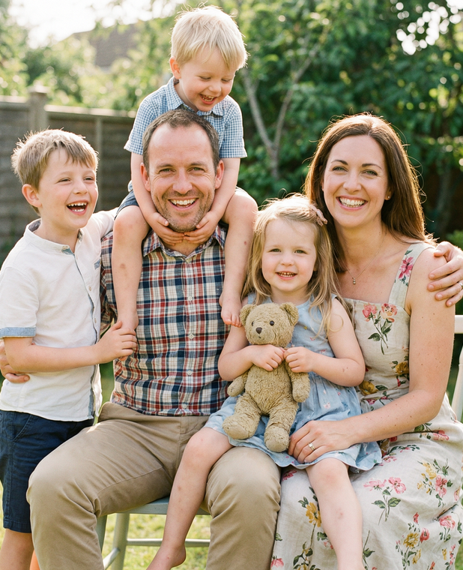
Built on Guardrails — Safety First, Always
A child-safety agent must itself be safe. Six commitments that make GuardianLoop trustworthy.
Physical prevention first
No unsafe wearables
⛨
AI is an extra layer; window locks, balcony guards and supervision remain the primary barriers
▶
fixed, safely mounted cameras only; nothing around a child's neck or reach
⚡
Deterministic emergency rules
⚿
Privacy by design
life-safety alarms never depend on an LLM's reasoning time
local processing, no facial identification, minimal retention
⊘
No false reassurance
⚒
Qualified professionals only
the app shows uncertainty and offline cameras honestly
electrical hazards go to certified electricians, never DIY advice
♥
Trust is the product behind the product.
Notes:
- Frame guardrails as the differentiator judges can trust: a child-safety agent must itself be safe.
- Walk the six commitments briefly — prevention first, no wearables, deterministic rules, privacy, honesty, professionals only.
- Emphasize: fixed, safely mounted cameras only — nothing around a child's neck or within reach.
- End on the caption: trust is the product behind the product.

Slide 10



One More Guardian in Every Home
Detect in seconds
→
Alert instantly
→
Resolve completely
GuardianLoop.Ai brings a missing layer of protection to UAE homes — watching balconies, windows and household hazards, and following every event through to verified resolution.
Thank you — Ravi Kumar D
UAE AI Agents Championship · October 2026
Because babies are our world. Let us keep it that way.
Notes:
- Recap the three verbs: detect in seconds, alert instantly, resolve completely.
- Restate the one-liner: a missing layer of protection for UAE homes, followed through to verified resolution.
- Thank the judges and state your name once more — Ravi Kumar D, UAE AI Agents Championship, October 2026.
- Deliver the closing line slowly: "Because babies are our world. Let us keep it that way."
- Invite questions.

